Slide 1
Tackling IPM Busters Symposium Introduction ESA-SEB 2017
Norm Leppla
University of Florida
Entomology and Nematology Department

Slide 2
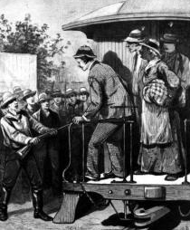
Yellow Jack in Jacksonville The 1888 Epidemic
They burned infected clothes, scorched homes and lit bonfires of pine and tar in the streets — a type of purification by fire. They even blasted off cannons every night, hoping the reverberations in the air might kill the infection.
Florida Times Union 2014

Slide 3
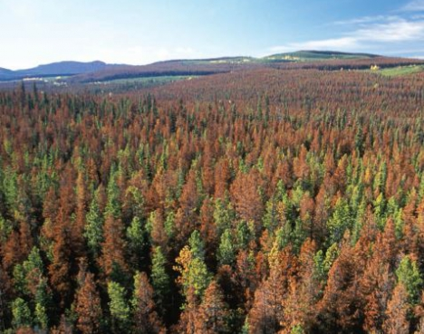
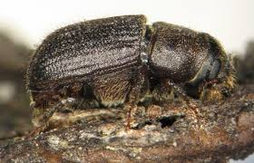
Mountain Pine Beetle Epidemic
In 1997, USFS scientists recommended preventing attack of the mountain pine beetle, Dendroctonus ponderosae, in the lodgepole pine forests of Colorado.
Beginning in 2003, new federal laws expediting logging on 9.6 million acres that are not based on science and could do more harm than good, some forest scientists said.
Naturally:wood
The Colorado Independent, 2014
Further, forest ecology doesn’t help when you’re stumping for votes by pushing logging projects under a jobs banner, or as a “do-anything” political response to a crisis like a wildfire topping the evening news.

Slide 4
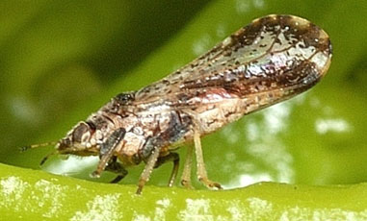
Citrus Greening Disease
Insecticide Program
ACP- June 1998, Greening– August 2005
UF/IFAS Citrus Extension
Citrus Health Management Areas (CHMAs) are grouping of commercial citrus groves in close proximity where growers coordinate Asian citrus psyllid control sprays to provide long-lasting effective psyllid
control to minimize movement of psyllids
between groves. Grower participation in
a CHMA is voluntary. (2011)

Slide 5
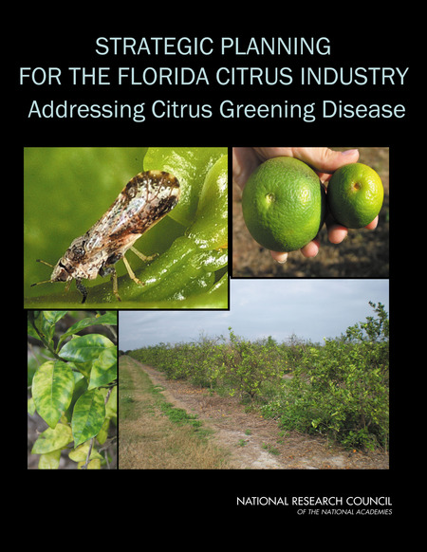
Original publication: December 1999
Committee on the Strategic Planning for the Florida, Citrus Industry, National Research Council, National Academy of Sciences. (2010)

Slide 6
Pest Management Programs
Invasive Pest
Resistant Crop
Competitors
Natural Enemies
Resistant Varieties
Vulnerable Crop
IPM Program
Cultural practices
Scouting, ID of pests & NEs
Conservation of comp. & NEs
Augmentation of NEs
Reduced-risk insecticides
Resistance management
Insecticide program
New insecticides
New formulations
New Application methods
Resistance management
N. C. Leppla, CAST, 2017

Slide 7
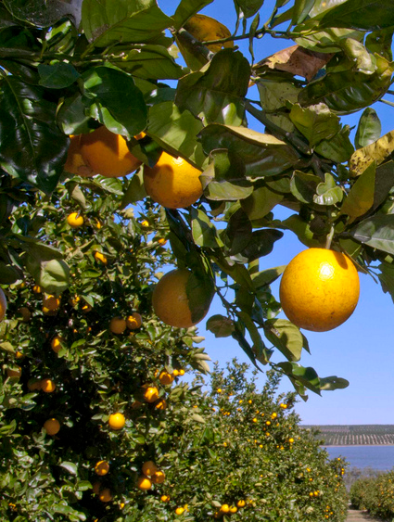
Citrus Greening Disease IPM
Tree Removal
Ensure infected trees will not serve as a source inoculum
Pruning of symptomatic branches is not successful
Propagation
Use clean bud wood, certified healthy trees
Purchase trees from a certified nursery
Scouting
Methods, frequency
Safety in the field
Asian Citrus Psyllid Management
Biological control
Area wide spay programs through CHEMAs
Speed sprayer and aerial application
Alternate Host Plants
Orange jasmine
Box orange, etc.
Antibacterial Management
Antibacterial Products
Crisis Declaration

Slide 8
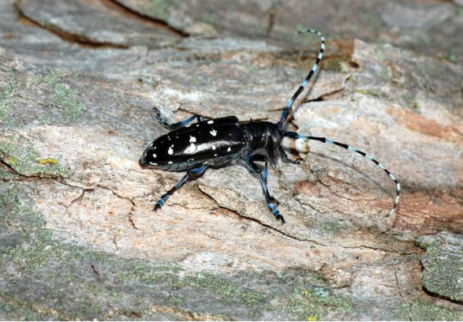
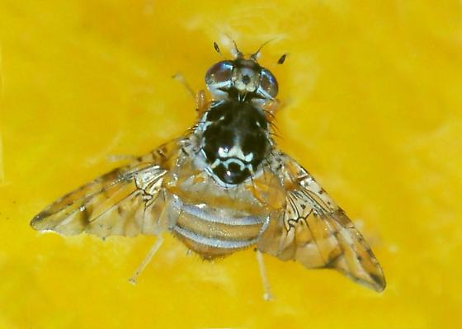
Plant Pest and Disease Programs to Prevent Establishment and Spread of Insects and Mites
Asian Longhorned Beetle
Cotton Pests
Spotted Wing Drosophila
Emerald Ash Borer
European Grapevine Moth
Fruit Flies
Grasshopper/ Mormon Cricket
Gypsy Moth
Imported Fire Ant
Japanese Beetle
Light Brown Apple Moth
Mediterranean Fruit Fly
Old World bollworm
Pine Shoot Beetle
Palm Weevils
Peter Trenchard, CAES
BugGuide
United States Department of Agriculture Animal and Plant Health Inspection Service

Slide 9
Tackling IPM Busters- David Owens
Brown Marmorated Stink Bug
Coordination, research/extension efforts, grower reaction, how IPM restored- Tracey Leskey/Tom Kuhar
Spotted Winged Drosophila
Coordination, psychological impact to growers, development of regional research coordination, extension- Hannah Burrack/Ash Sial
Whitefly Q&B biotypes
On the horizon, extension, grower concerns, regulatory concerns, IPM adoption, strategy- Hugh Smith/Cindy McKenzie
Western Flower Thrips
Introduction, grower reaction, resistance management- Joe Funderburk
Oriental Fruit Fly
State response, information dissemination, grower response- Trevor Smith
Old World Bollworm
Preparing for, monitoring, Extension, and the plan- Amanda
Hodges

